Slide 1
Dynamic Programming
~Pradeep Singh

Slide 2
Let us understand the idea with an example :
int fibo(int x){
if(x<0)return 0;
if(x<2)return x;
return fibo(x-1)+fibo(x-2);
}
int dp[N];//memoization
int fibo2(int x){
if(x<0)return 0;
if(x<2)return x;
if(dp[x]>0)return dp[x];
return dp[x]=fibo2(x-1)+fibo2(x-2);
}

Slide 3
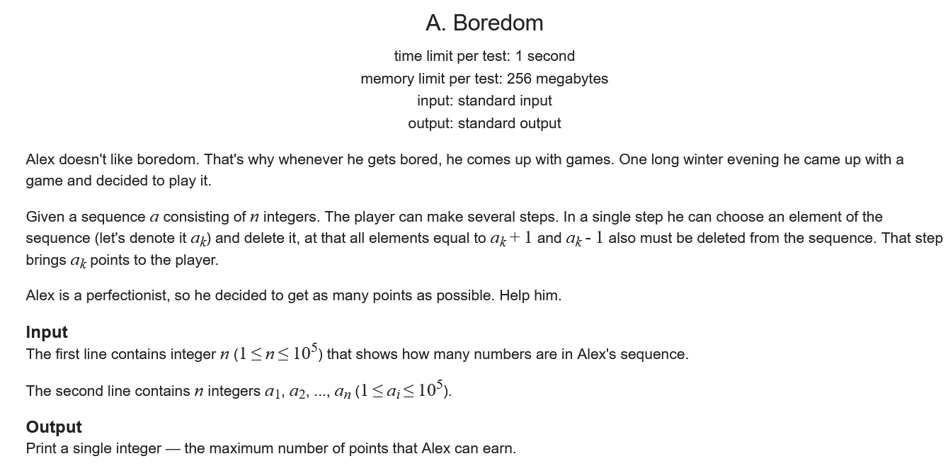
Problem 1:

Slide 4
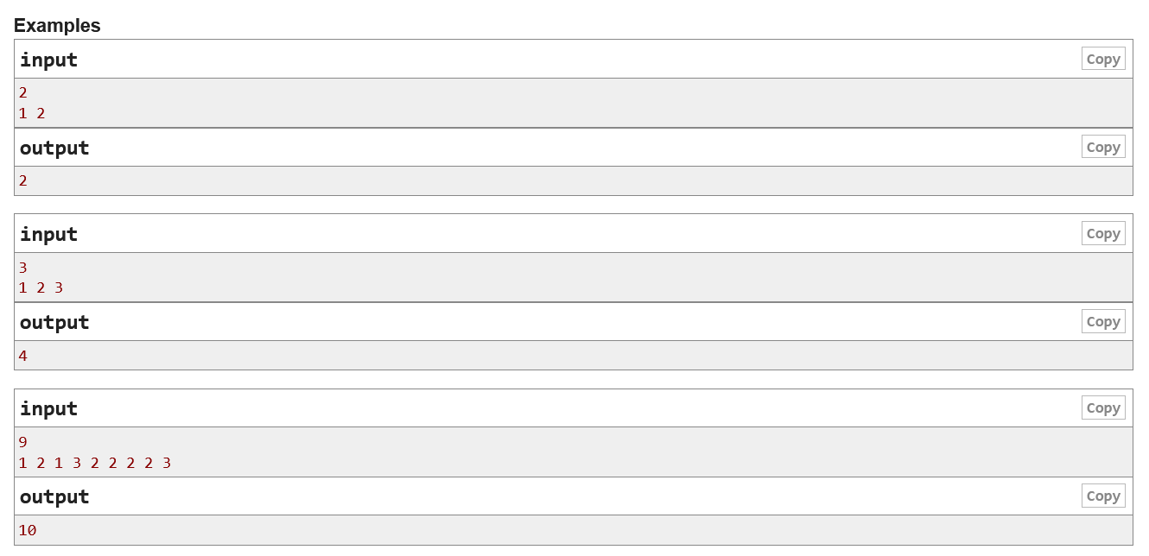

Slide 5
Implementation:
int n,x,cnt[100001], ans[100001];
void solve(){
cin >> n;
for(int i = 0; i < n; i++){
cin>>x;
cnt[x]++;
}
ans[1]=cnt[1];
for(int i = 2;i < 100001; i++){
ans[i] = max(ans[i-1], i*cnt[i]+ans[i-2]);
}
cout << ans[100000];
return;
}

Slide 6
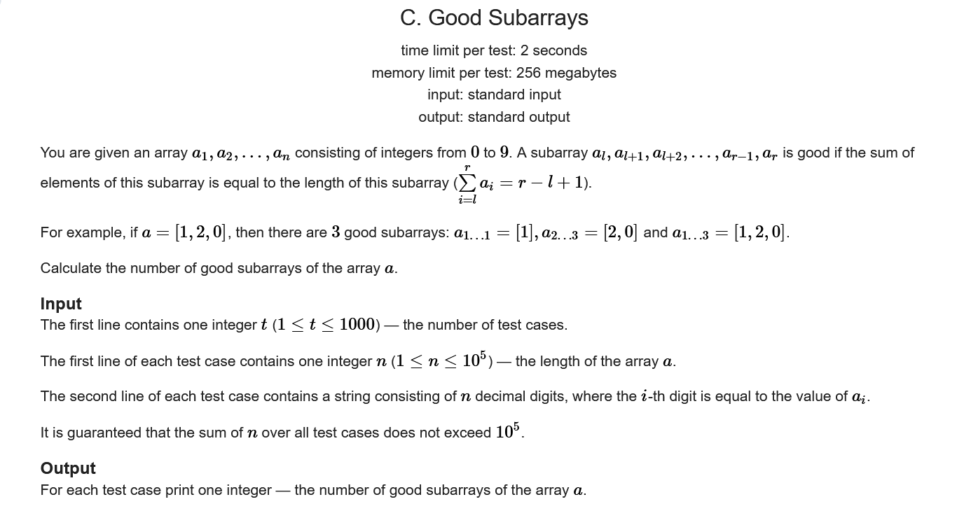
Problem 2:

Slide 7
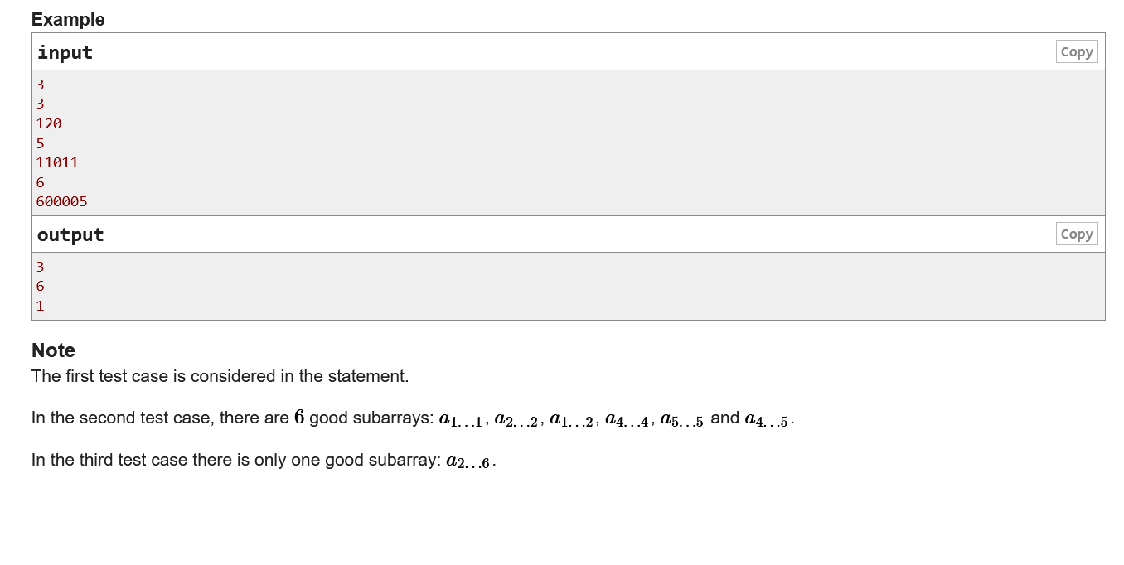

Slide 8
Implementation
void solve(){
int n, ans=0;
cin >> n;
int pref[n];
vector<int> v,v2;
for(int i = 0; i < n; i++){
char c; cin >> c;
pref[i] = c-'0';
if(i)pref[i] += pref[i-1];
v.push_back(pref[i]-i);
}
v.push_back(1);
sort(v.begin(),v.end());
v.push_back(2e9);
int x=1;
for(int i=0;i<=n;i++){
if(v[i]!=v[i+1]){
ans+=(x*(x-1))/2;x=1;
}
else x++;
}
cout << ans <<"\n";
return;
}

Slide 9
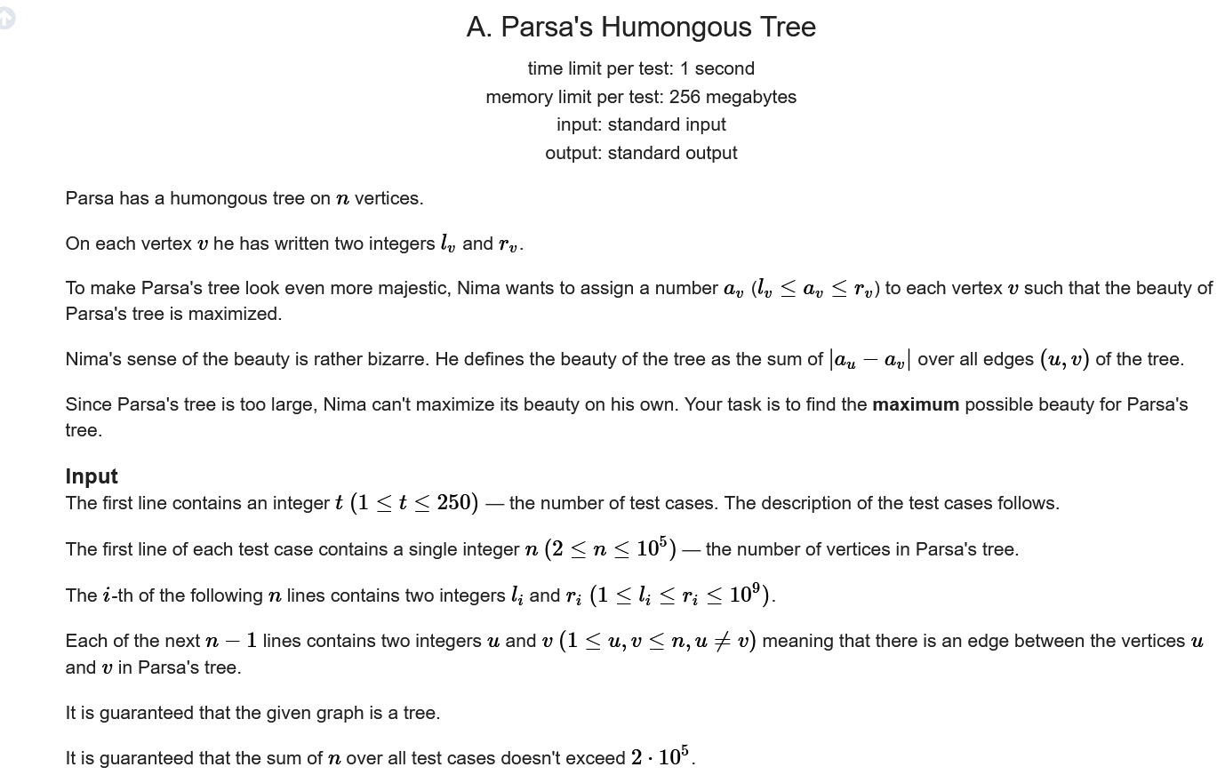
Problem 3:

Slide 10
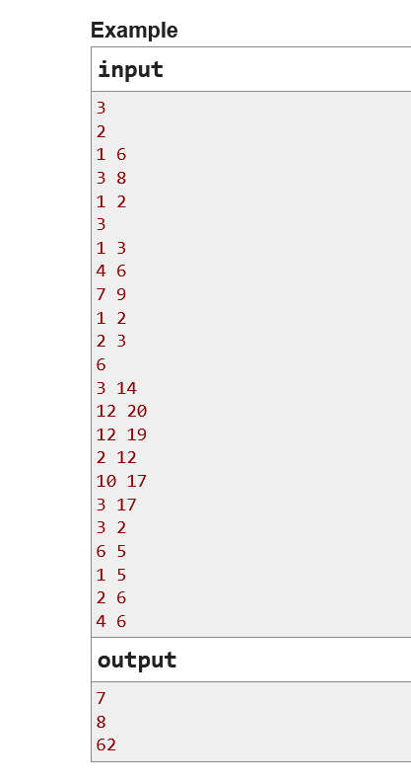
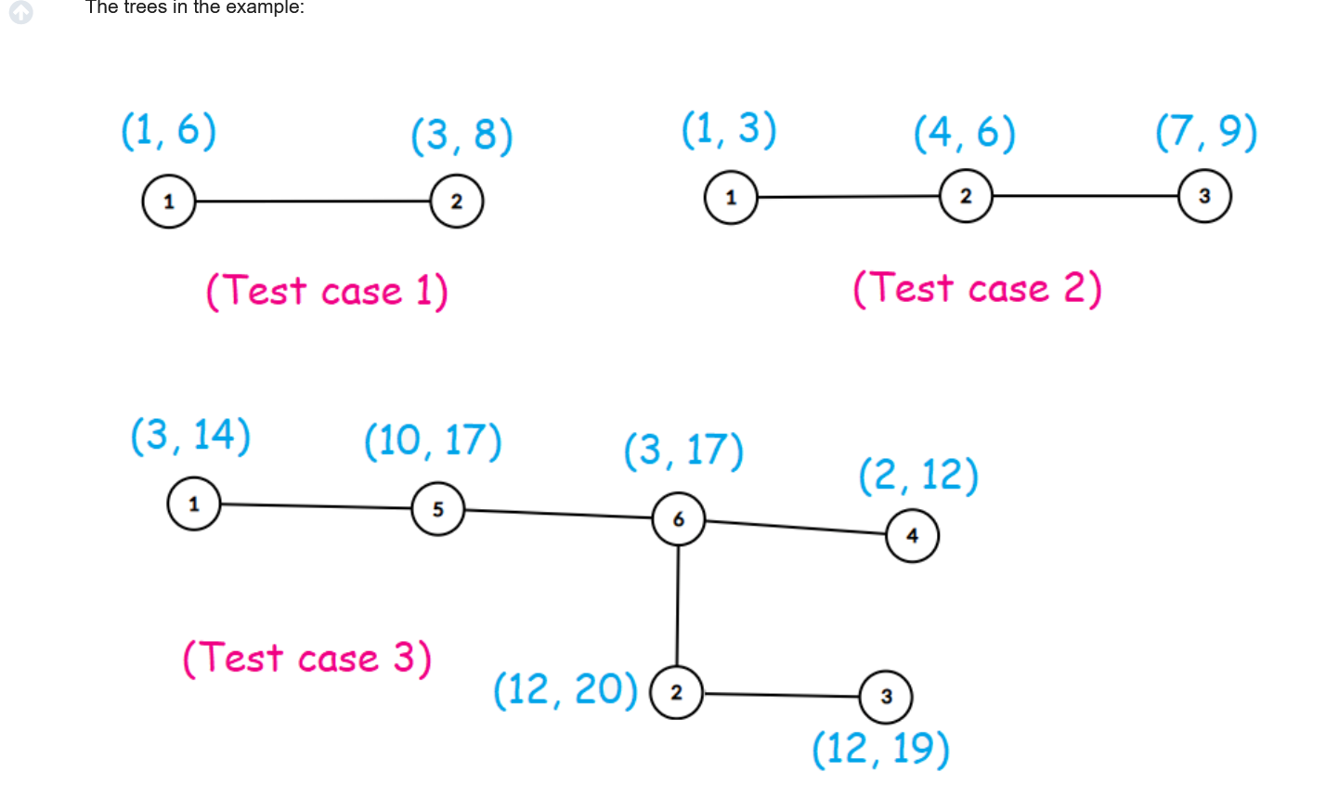

Slide 11
Implementation:
int lv[100005],rv[100005],dp[100005][2];//dp initialized with -1
vector<vector<int>> adj(N);//adjecency list
int ans(int x, int p, bool l){
int ans=0;
if(l)if(dp[x][1] != -1)return dp[x][1];
if(!l)if(dp[x][0] != -1)return dp[x][0];
for(int i = 0; i < adj[x].size(); i++){
int y = adj[x][i];
if(y == p)continue;
if(l)
ans += max(
abs(answ(y,x,1))+abs(lv[x]-lv[y])
,abs(answ(y,x,0)+abs(lv[x]-rv[y])));
else
ans +=max(
abs(answ(y,x,1))+abs(rv[x]-lv[y])
,abs(answ(y,x,0)+abs(rv[x]-rv[y])));
}
if(l) dp[x][1] = ans;
else dp[x][0] = ans;
return ans;
}

Slide 12
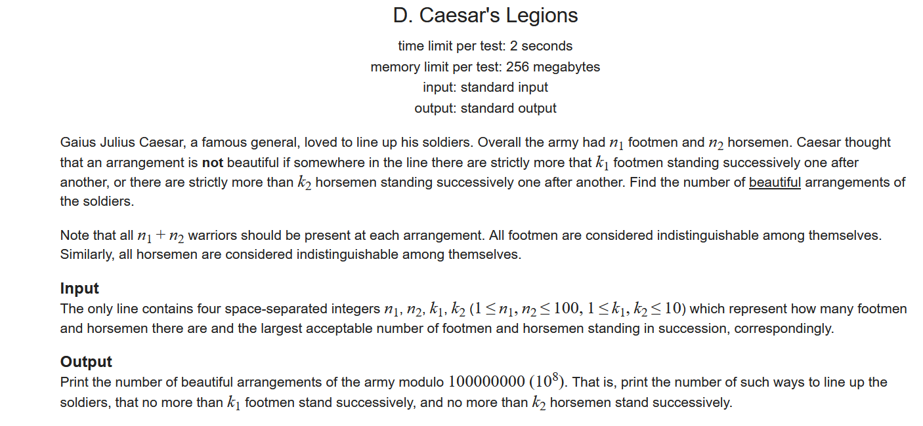
Problem 4:

Slide 13
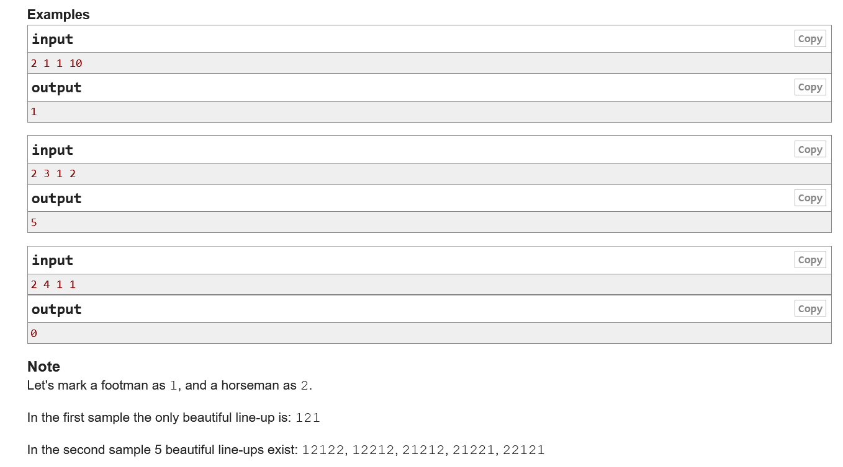

Slide 14
Implementation:
else{
if(m<=0)return 0;
if(dp[n][m][x]!=-1)return
dp[n][m][x];
int res=0;
for(int i=1;i<=q;i++){
res+=ans(n,m-i,1);
}
res%=M;
dp[n][m][x]=res;
return res;
}
}
int n,m,p,q;
int dp[102][102][2];
int ans(int n,int m,bool x){
if(n < 0||m < 0)return 0;
if(n == 0 && m == 0)return 1;
if(x){
if(n<=0)return 0;
if(dp[n][m][x]!=-1)return dp[n][m][x];
int res=0;
for(int i=1;i<=p;i++){
res+=ans(n-i,m,0);
}
res%=M;
dp[n][m][x]=res;
return res;
}

